Slide 1
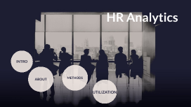
HR Analytics :Driving Business Decisions with Data
Presented By : PRAMITA CHAKRABORTY
Date: 25/12/2024

Slide 2
Introduction
Definition of HR Analytics
Human Resources (HR) analytics, also known as people analytics, workforce analytics, or talent analytics, involves collecting and analyzing workforce data to improve human resource practices and make data-driven decisions. It focuses on metrics and insights related to employee performance, retention, recruitment, and overall employee experience. By leveraging HR analytics, organizations can better understand their workforce, optimize talent management processes, and drive business outcomes.
Importance of HR Analytics in business decision making
Data-Driven Decisions: HR analytics provides valuable insights derived from data. This allows businesses to move away from gut feelings and intuition, making more informed and objective decisions.
Employee Retention: By analyzing data on employee turnover engagement, and satisfaction, companies can identify factors that contribute to employee retention and address issues proactively.
Recruitment Efficiency: Analytics can streamline the recruitment process by identifying the most effective sources of talent, predicting candidate success, and reducing time-to-hire..

Slide 3
Benefits of HR Analytics
Enhanced Talent Management: HR analytics provides valuable insights into employee skills, performance, and potential, helping organizations make better decisions about hiring, promotions, and development.
Increased Employee Engagement: By understanding the factors that drive employee satisfaction and engagement, companies can create targeted initiatives to improve workplace culture and boost morale.
Better Retention Strategies: Analytics can identify patterns and predictors of employee turnover, allowing businesses to implement effective retention strategies and reduce attrition rates.
Cost Savings: By identifying inefficiencies and areas for improvement, HR analytics can help reduce costs associated with recruitment, training, and employee turnover.
Data-Driven Decisions: Organizations can make informed decisions based on data insights rather than intuition, leading to more effective and strategic HR practices.

Slide 4
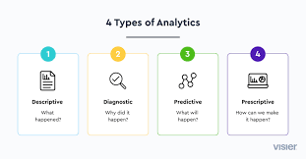
Types of HR Analytics
Descriptive Analytics: This type involves analyzing historical data to understand what has happened in the past. It focuses on metrics such as turnover rates, average time to hire, and employee demographics. Descriptive analytics helps in identifying trends and patterns within the workforce.
Diagnostic Analytics: This type goes a step further by examining the causes behind past events. It helps in understanding why certain patterns or trends occurred by exploring the relationships between different variables. For example, diagnostic analytics can reveal the reasons behind high turnover rates in a specific department.
Predictive Analytics: This type uses historical data and statistical models to predict future outcomes. It helps organizations anticipate trends and make proactive decisions. For instance, predictive analytics can forecast which employees are at risk of leaving the company, allowing HR to take preventive measures.
Prescriptive Analytics: This type provides recommendations for actions to achieve desired outcomes. It combines data analysis with optimization techniques to suggest the best course of action. For example, prescriptive analytics can recommend specific training programs to improve employee performance and engagement.

Slide 5
HR Analytics tools and technologies
HR analytics tools and technologies are essential for organizations looking to optimize their human resources by transforming data into actionable insights. Here are some of the top HR analytics tools and technologies:
HR Analytics Tools:
R: Great for statistical analysis and visualization, especially with large datasets.
Tableau: A popular business analytics tool for creating interactive and shareable dashboards.
Power BI: A business analytics service by Microsoft that provides interactive visualizations and business intelligence capabilities.
Python: Another powerful programming language for data analysis, often used interchangeably with R.
Key Features to Look For:
Dashboards and Visual Representations: Easy-to-read graphs and charts that make data come alive.
Predictive Analytics: Tools that forecast trends and help you prepare for them.
Integration Capabilities: The ability to sync with HR systems like payroll or Applicant Tracking Systems (ATS).
Customizable Reports: Flexibility to dive into the metrics that matter most to you

Slide 6





Power Bi

Slide 7
Define HR Business problem
A business problem in HR analytics is a specific issue or challenge within the realm of human resources that can be addressed and solved using data-driven insights. These problems often revolve around optimizing workforce management, improving employee performance, or enhancing overall organizational efficiency. Here are some common business problems in HR analytics:
Examples of HR Business Problems
High Employee Turnover: Understanding the reasons behind high turnover rates and identifying strategies to improve employee retention.
Talent Acquisition: Enhancing recruitment processes to attract and hire the best candidates more efficiently.
Employee Engagement: Measuring and improving employee engagement to boost productivity and job satisfaction.
Performance Management: Identifying top performers and underperformers and implementing effective performance management strategies.

Slide 8
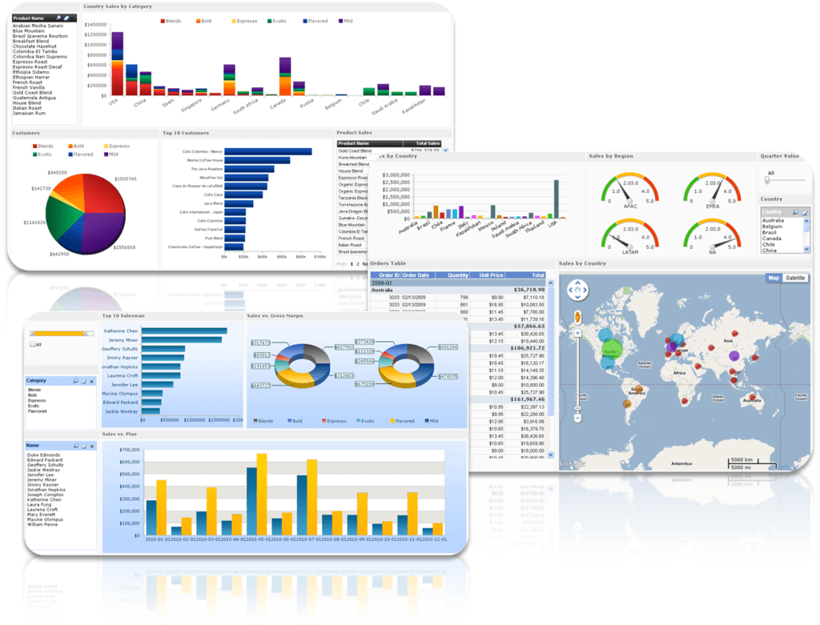
How HR Analytics Can Help to making a dashboard
Predictive Analytics: Using historical data to predict future HR-related outcomes, such as employee turnover or hiring needs.
Data Collection and Analysis: Gathering data from various HR systems (e.g., payroll, performance reviews, employee surveys) and analyzing it to uncover patterns and trends
.
Dashboards and Reporting: Creating visualizations and reports to communicate insights and support decision-making.
Actionable Insights: Providing recommendations and strategies based on data analysis to address specific HR business problems.

Slide 9
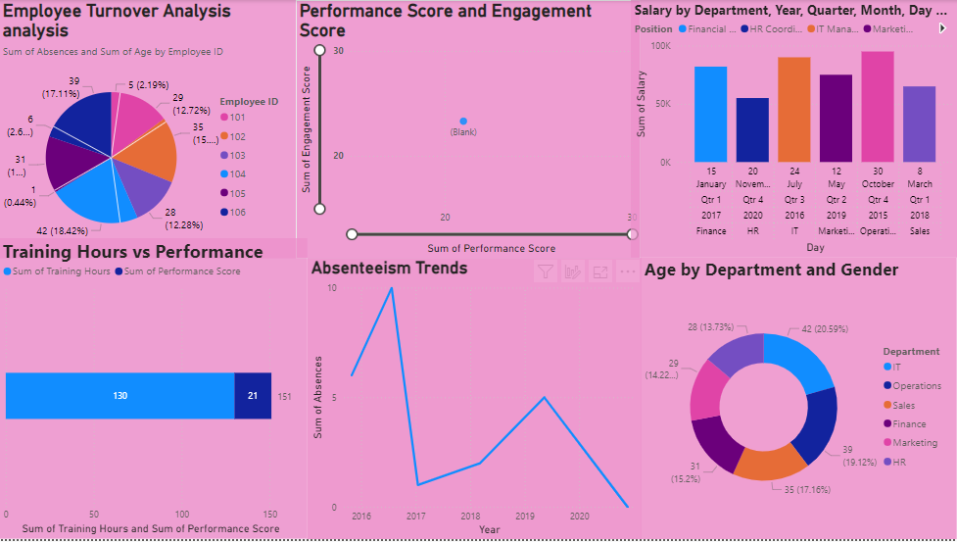

Slide 10
THANK YOU

